Slide 1

Department of Computer Engineering
BE Project
Academic Year 21-22
Marathwada Mitra Mandal’s College of Engineering, Karve Nagar, Pune
Accredited with 'A' Grade by NAAC
NLP - Speech2Code
TEAM MEMBERS: GUIDE:
Bhavika Mauli Karale (BC170) Dr. Aarti Agarkar
Sameeksha Avinash Joshi (BC171)
Siddharaj Sudhakar Gangawane (BC173)
Rutuja Rajendra Shewale (BC174)

Slide 2
Problem Statement:
Building an assistive technology tool capable of assisting programmers
to program in JavaScript using their voice.

Slide 3
Motivation:
Repetitive strain injury (RSI) is a syndrome that affects thousands of professionals around the world every year, among these professionals are programmers, professionals who tend to make extensive use of their hands in carrying out their tasks and that is why more susceptible to RSI. Programmers affected by this syndrome have great difficulty in using their hands and consequently great difficulty in carrying out their main activity: programming, a historically text-based activity that requires extensive use of the hands.
That said, we come to the central theme of this work: the building an assistive technology tool capable of helping programmers to program in the JavaScript language using their voice.

Slide 4
Goals of the Project:
The tool aims to enable programmers to program without using their hands, using only voice commands, parse sentences belonging to a given grammar using stack automata, how to connect and control code editors using UI automation tools, the process of creating a code editor extension Visual Studio Code and the creation of a cross-platform application using ReactJS and the Electron framework.

Slide 5
Objective of the Project:
To use voice commands for programming and avoid Repetitive Strain Injury (RSI) among programmers.

Slide 6
Literature Survey:
Sr No. | Title | Author | Advantages | Disadvantages
1 | Repetitive Strain Injury among Computer Users: A case study in telecommunication company. | Nurul Huda Baba, Dian Daruis | Paper defines what Repetitive Strain Injury is and causes of RSI. It helps us understand the root of RSI and the people who are most likely to get affected by it. | The measures to be taken by the people to avoid RSI are not given clearly. Along with this, the survey is conducted on a small group of people due to which there are chances the the results may vary more.
2 | A Study on Automatic Speech Recognition | Saliha Benkerzaz, Abdeslem Dennai, Youssef Elmir | The paper gives an overview of the main definitions of Automatic Speech Recognition. The authors have discussed about the speaker dependence systems, architecture and working of ASR. | An in depth study of Language model, acoustic model and pronunciation model is missing.

Slide 7
3 | Automatic Identification of Stop Words. | W. John Wilbur, Karl Sirotkin | This paper presents an automated theory for identification of stop words which are irrelevant to the useful content of a particular document. This paper replace the conventional nearest neighbor method to find such words by a more efficient way of applying cosine similarity of the document-document pair to the vector retrieval model. | This approach appears limited due to only document-document similarity. So cannot be predicated to be useful for general textual queried documents. More thought needs to be given on which terms are indexed. The application of this theory on general texted queries remains untested.
4 | Deep Variational Filter Learning Models. | Purvi Agarwal, Sriram Ganapathy | The proposed method uses an unsupervised data-driven modulation filter learning approach that preserves the key modulations of speech signal. This is achieved by a deep generative modeling framework to learn modulation filters using convolutional variational autoencoder. | Using Convolutional Variational Autoencoder can give blurry outputs.

Slide 8
5 | Unifying Speech Recognition and Generation with Machine Speech Chain. | Andros Tjandra, Sakriana Sakti, Satoshi Nakamura | Paper proposes a closed-loop between ASR and TTS model to construct a machine speech chain mechanism. By using similar sequence-to-sequence architecture and interchangeable source-target domain, it allows to train both labeled and unlabeled data in a single loop. | The TTS system is very time consuming as it requires huge databases and hard-coding of combination to form these words. As a result speech synthesis consumes more processing power

Slide 9
Functional and Non-functional Requirements:
Functional Requirements: Admin is considered the person with ultimate authorities in the system with many functionalities.
Admin can select whether he wants to use voice for coding or whether he wants to convert commands written in simple English to his code.
Admin can change the program’s main settings like selecting a preferred language for giving voice commands, selecting the editor of choice for coding and selecting the debug option.
Furthermore, admin select between whether he wants Azure speech to text service or simple Chrome speech recognition system for his voice coding.
Admin has full control of when to start and stop the mic recording.

Slide 10
Functional and Non-functional Requirements:
Non-functional Requirements:
With ideal conditions, system response should be fast and error free.
System performance should not decrease with time or by usage.
System should recognize any voice without any fault.
Performance and speed should not depend on newer or older versions of VSCode editor or Chromium based search engine.
The system is easy to use and learn, a help page is also provided in the menu for all new users.
Meaningful notification messages will be displayed when some error happens.

Slide 11
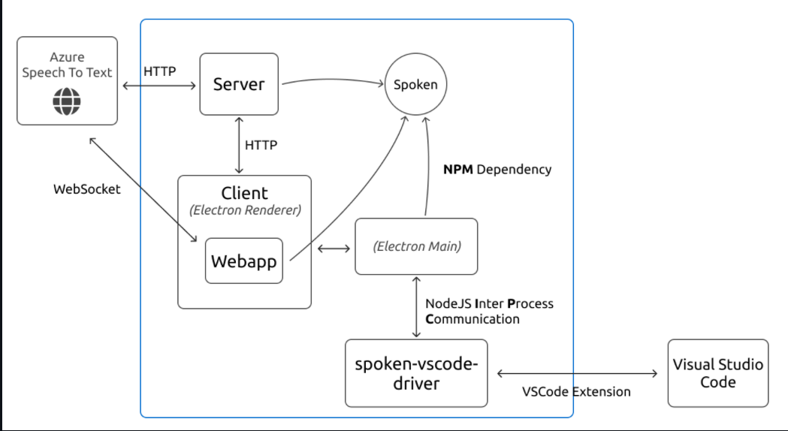
System Architecture:
:

Slide 12
Main modules:
Server : are responsible for the application UI, capture audio and transform audio into text.
Spoken: is responsible for testing if a given phrase is a valid voice command and to extract important information out of it.
Spoken VSCode Extension/ Webapp is a Visual Studio Code extension able to receive commands to manipulate VSCode. Is through this extension that Speech2Code is able to control the Visual Studio Code.

Slide 13
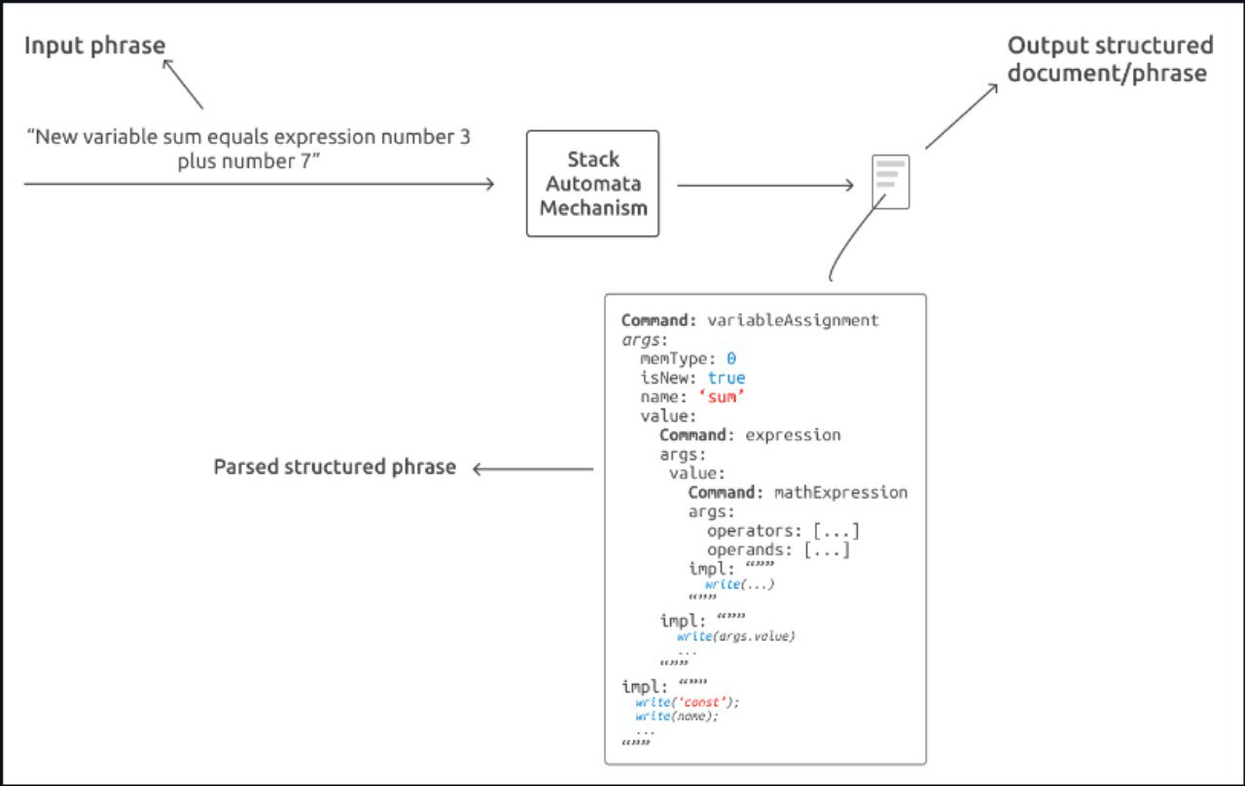

Slide 14
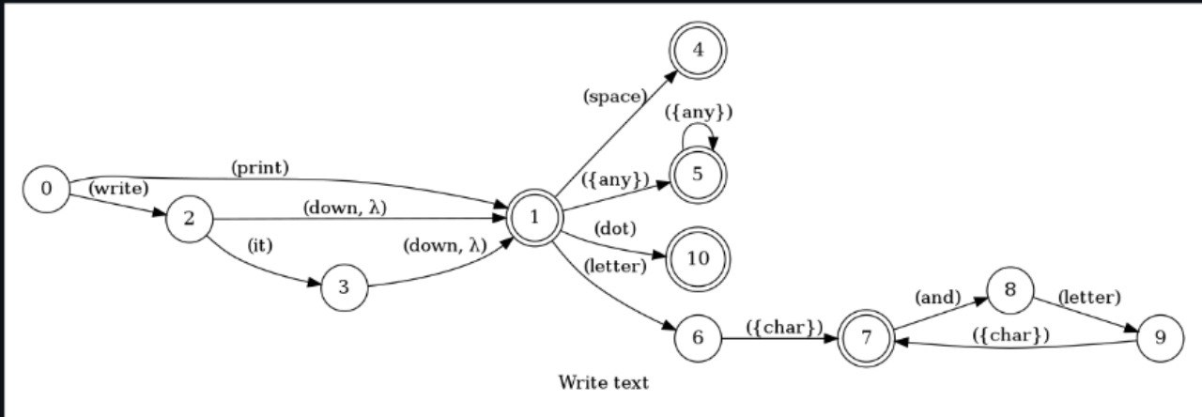

Slide 15
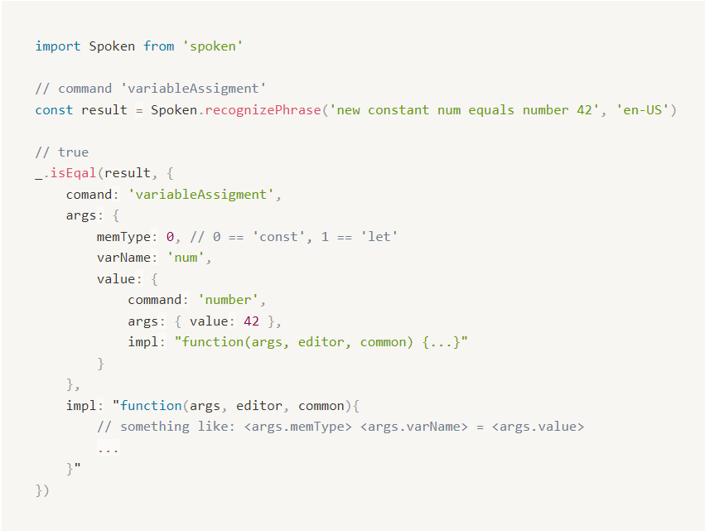

Slide 16
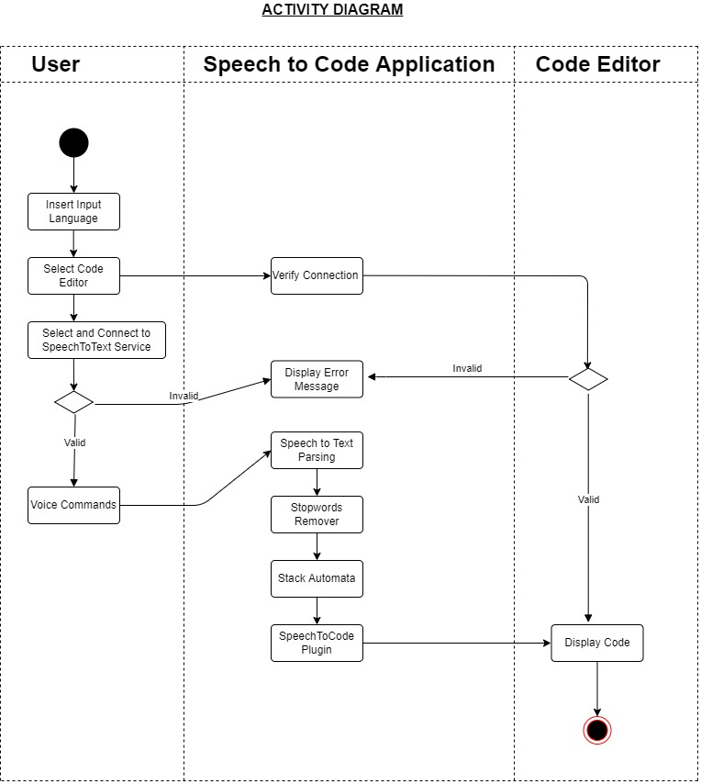
UML Diagrams:
:

Slide 17
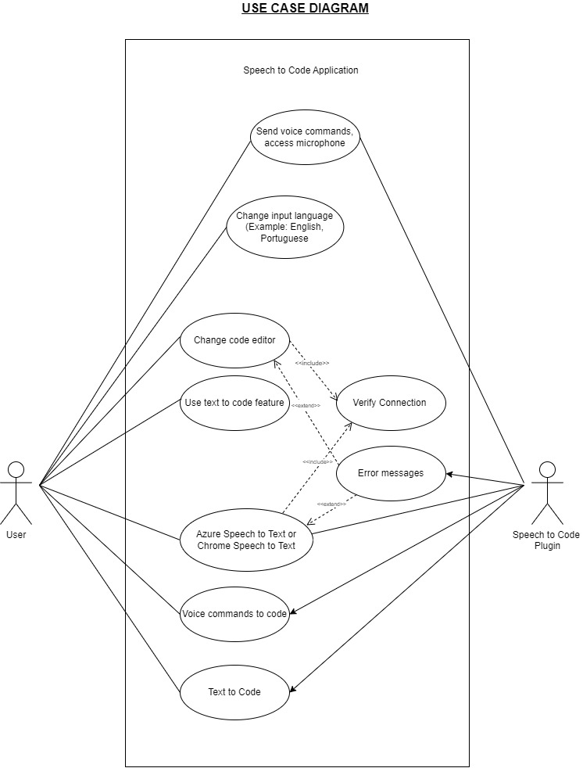
UML Diagrams:
:

Slide 18
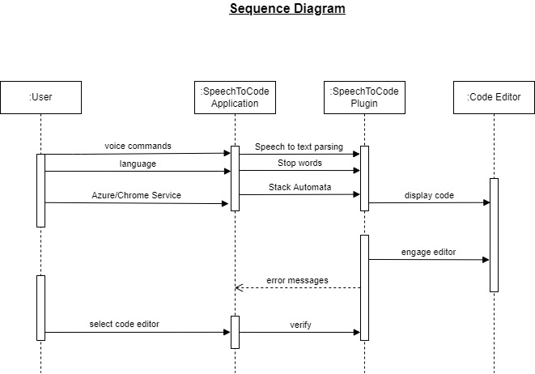
UML Diagrams:
:

Slide 19
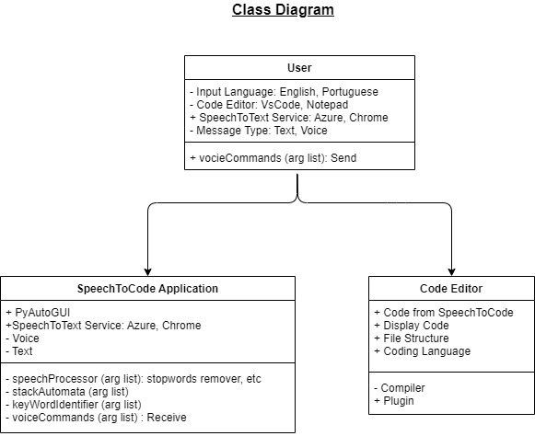
UML Diagrams:
:

Slide 20
Feasibility Study:
A reasonable priced voice to code extension does not exist at the time study was conducted.
Introduction of multiple languages for giving voice commands was done. This increased usefulness and flexibility of the system.
The extension worked properly across all platforms like Linux, Mac and windows.
The system used both the paid service like Azure Speech to Text service and free Chrome’s inbuilt Speech to Text as per users choice and showed no variations in results.
The findings of this feasibility study indicated that an effective voice based training delivery system could be developed by integrating an IBM clone personal computer with a graphics board and supporting software, signal processing board and supporting software for audio output and input, and instructional authoring software.

Slide 21
Identification of Constraints and Risk Analysis:
Constraints:
Errors in Speech Identification
Inability to understand spoken words
Risk Analysis:
Learning curves lead to delays
Users have inaccurate expectations

Slide 22
Use Cases:
Voice recognition software can be used when the user needs to generate a large volume of textual content without the need of writing manually.
It can also be used by users who are unable or have great difficulty using a keyboard.
It can be used by individuals who are not well-versed with the syntax of a particular language but still wish to code.
It can be used by programmers suffering from Repetitive Strain Injury(RSI).

Slide 23
Identification of Data and Data Relationship:
Data is identified in this project as human voice which is given as input.
Further these voice commands are transformed into text which is served as data to Azure Speech to Text service and later parsed by the developed VSCode extension.
Input phrases are passed to the Stack Automata Mechanism which outputs the structured document/phrase.
For example, “New variable sum equals expression number 3 plus number 7” is taken as input data. Now following the Stack Automata Mechanism, output will be as follows: variableAssignemnt: true, name: sum
expressionType: mathArguement: true, type: add
data: 3, 7
output: sum = 3+7

Slide 24
Industry Applications:
Speech recognition systems have applications in several areas. In fact, any activity that involves human-machine interaction can potentially utilize these systems. Currently, several applications are already being designed with a built-in speech recognition system.
This assistive technology application is capable of enabling programmers to program in JavaScript without the use of their hands, using only voice commands. The purpose of the application is to enable programmers who are unable or with great difficulty to use their hands, whether due to injury or disability, to continue exercising their profession.
This same methodology can be used in the creation of other applications with a similar purpose, such as a tool that, in addition to JavaScript, also supports Python.

Slide 25
Software Development Life Cycle
Introduction to Agile SDLC Model
Agile software development refers to a group of software development methodologies based on iterative development, where requirements and solutions evolve through collaboration between self-organizing cross-functional teams.

Slide 26
Advantages of Agile Model:
Customer satisfaction by rapid, continuous delivery of useful software.
People and interactions are emphasized rather than process and tools. Customers, developers and testers constantly interact with each other.
Working software is delivered frequently (weeks rather than months).
Face-to-face conversation is the best form of communication.
Close, daily cooperation between business people and developers.
Continuous attention to technical excellence and good design.
Regular adaptation to changing circumstances.
Even late changes in requirements are welcomed.

Slide 27
Disadvantages of Agile Model:
In case of some software deliverables, especially the large ones, it is difficult to assess the effort required at the beginning of the software development life cycle.
There is lack of emphasis on necessary designing and documentation.
The project can easily get taken off track if the customer representative is not clear what final outcome that they want.
Only senior programmers are capable of taking the kind of decisions required during the development process. Hence it has no place for newbie programmers, unless combined with experienced resources.

Slide 28
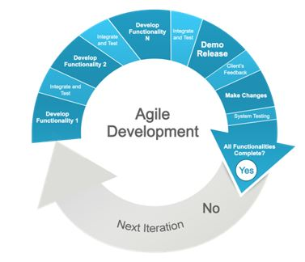
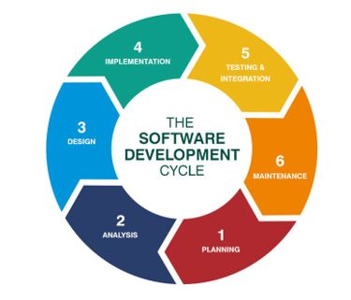

Slide 29
When to use Agile model:
When new changes need to be implemented. The freedom agile gives to change is very important. New changes can be implemented at very little cost because of the frequency of new increments that are produced.
To implement a new feature the developers need to lose only the work of a few days, or even only hours, to roll back and implement it.

Slide 30
Category of the Project:
Application

Slide 31
Hardware and Software Requirements:
The minimum requirements for the application to work fully are as follows:
Network:
Stable and fast internet connection
Operating System:
Tested on Windows 10 only
Memory:
At least 3GB of ram and 270MB of available disk space
Visual Studio Code:
Tested with version 1.55.2 of VS Code

Slide 32
References:
Repetitive Strain Injury (RSI) among computer users: A case study in telecommunication company
Nurul Huda Baba, Dian Darina Indah Daruis
2. A Study on Automatic Speech Recognition
Sahila Benkerzaz,Youssef Elmir, Abdeslem Dennai
3. Automatic Identification of Stop Words.
W John Wilbur, Karl Sirotkin
4. Deep Variational Filter Learning Models for Speech Recognition
Purvi Agrawal, Sriram Ganapathy
5. Unifying Speech Recognition and Generation with Machine Speech Chain
Andros Tjandra,, Sakriani Sakti, Satoshi Nakamura

